Slide 1

AI-Powered Fitness Coach
by Oladele Oluwadamilola

Slide 2
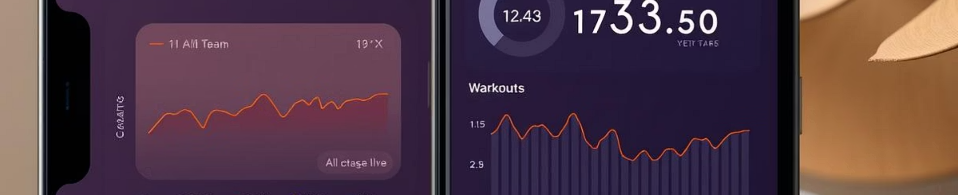
Introducing SmartFit: AI-Powered Fitness Coach
Personalized Workouts
Real-Time Feedback
Progress Tracking
AI creates adaptive routines tailored to your body and goals.
Instant posture and form corrections using smartphone sensors.
Motivational insights and data-driven recommendations for growth.

Slide 3
Market Opportunity
Fitness Industry Growth
Target Audience
Projected to reach $50B by 2027 with tech-driven solutions leading.
Millennials & Gen Z prioritizing convenience and personalized health.

Slide 4
Competitive Advantages
Cutting-edge AI
User Engagement
Proprietary machine learning algorithms outperform current apps.
Gamification and social features increase retention substantially.
Affordable Access
Subscription model with free basic version disrupts market pricing.

Slide 5
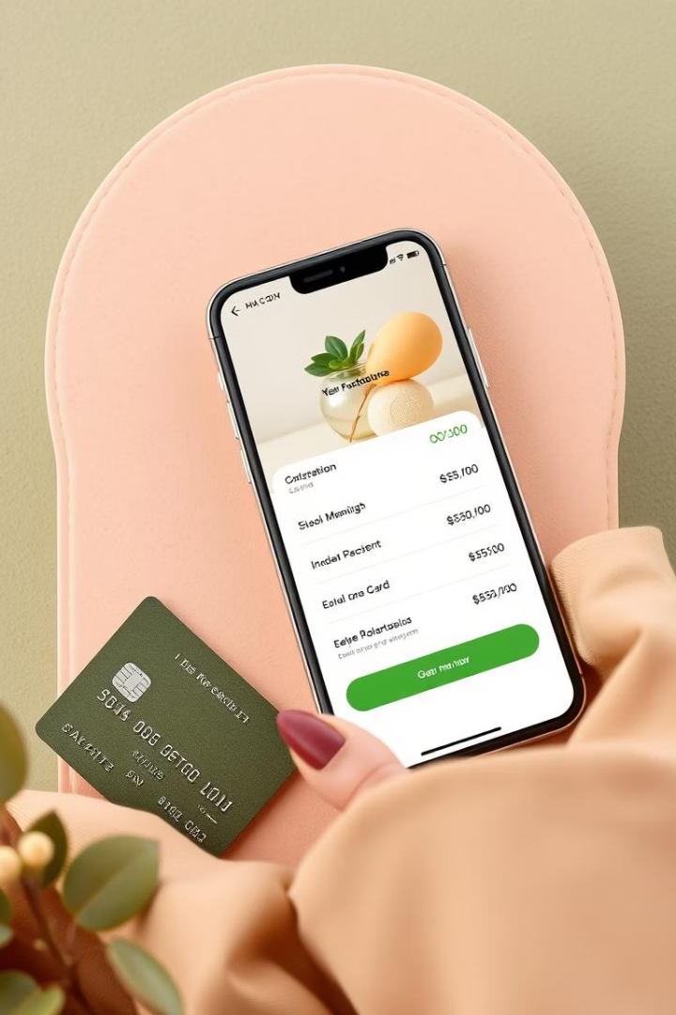



Business Model & Monetization
Freemium Access
Users start free, encouraging trial and adoption.
Premium Subscription
Unlocks advanced features, personalized plans, and coaching.
Partnerships
Collaborations with gyms and wearables for mutual growth.

Slide 6
Go-to-Market Strategy
1
Q1 - Beta Launch
Invite influencers and early adopters for feedback.
2
Q2 - Marketing Push
Targeted ads and partnerships boost visibility.
3
Q3 - Expansion
Add new features and scale user acquisition globally.

Slide 7
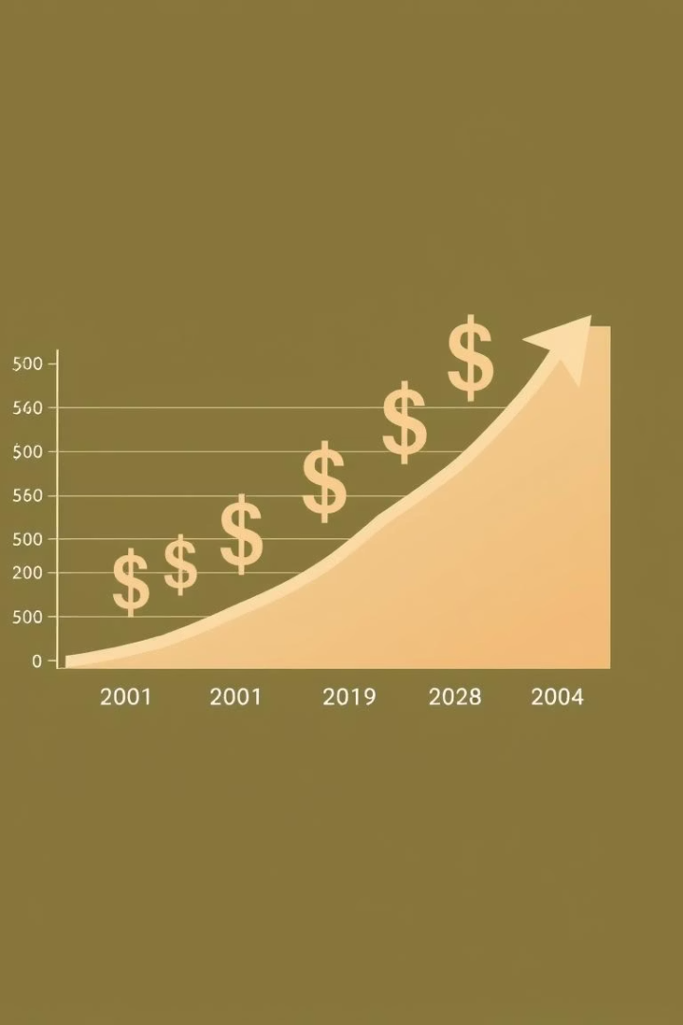
Financial Projections
$5M
Year 1 Revenue
Initial traction through subscriptions and partnerships.
20%
Profit Margin
Improved through scalable technology and efficient marketing.
500K
Active Users
Expected by end of year two with global reach.
$15M
Year 3 Revenue
Growth from premium subscribers and brand collaborations.

Slide 8
Key Takeaways & Next Steps
Innovative Product
Market Potential
Investment Opportunity
SmartFit revolutionizes fitness with smart AI coaching.
Strong growth opportunity with scalable business model.
Seeking capital to accelerate growth and market entry.
Join us in transforming how millions achieve fitness goals. Let's schedule a follow-up to discuss investment details.

